Slide 1

Brain Tumor Detector
Nuno Silva

Slide 2
Table of contents
Industrial Need
Demonstration
01
02
The Code
Challenges and the Future
03
04

Slide 3
01
Industrial Need

Slide 4

Biomedicine can get quite dull

Slide 5
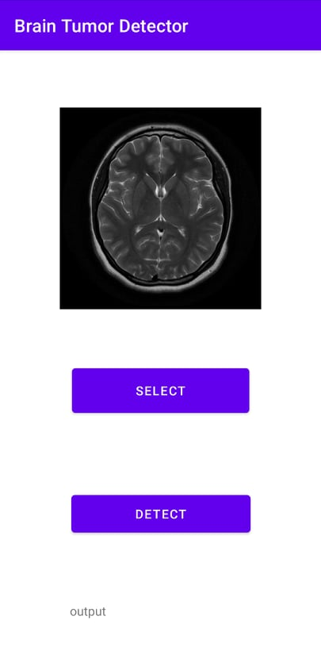
A Solution

Slide 6
02
Demonstration

Slide 7
03
The Code

Slide 8
The code
Convolutional Neural Network
Treating the images
CNN Binary Image Classifier
Convert model into Tflite
Design the app on Android Studio

Slide 9
04
Challenges and the Future

Slide 10
Challenges and the Future
Designing the app on Java
Further fine-tuning
Automate the process
Make it available for other types of tumor

